Slide 1


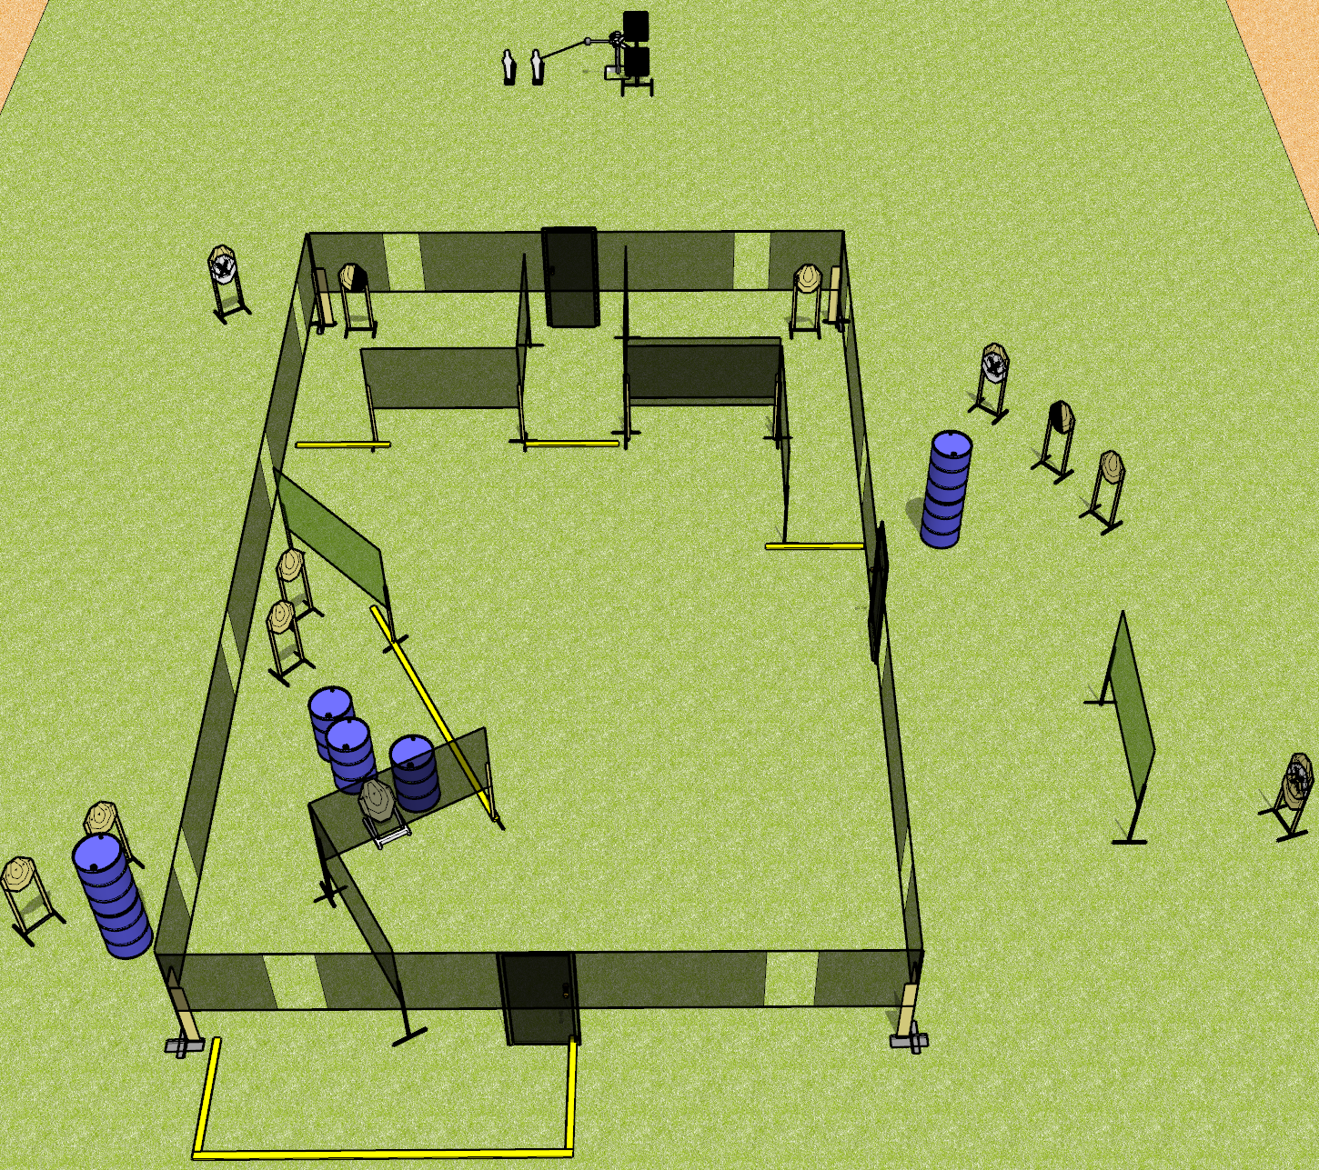
 | Dothan Gun Club – USPSA Match Leftovers Course Designer : Drew Coleman
Round Count 30 rounds 13 IPSC 2 mini 2 plates
Equipment List 4 wall feet 1 left + 1 right diag, 1 50% for low target 11 targets (9 + 2NS) Red stitch swinger + activator

Slide 2
Leftovers
Written Stage Briefing
Leftovers is a 30 round, 150-point, Comstock course of fire. There are 13 IPSC targets and 4 steel. The best 2 hits on cardboard will score and steel must fall to score.
The swinger is activated by poppers and remains visible at rest. Must be activated before being engaged.
Handgun start position is anywhere inside the shooting area, wrists below belt. Handgun is loaded and holstered.
PCC start position is anywhere inside the shooting area, stock on belt. Loaded carbine is held with both hands, safety on.
On the audible start signal, engage targets as they become available from within the shooting area.
Front and side doors (if present) must be shut prior to the start signal. Back door near the swinger will remain open.

